Slide 1
Track-My-FireFighter
DashBoard
CMPE 280-Spring 2020
Vatsal Makani
Vaishnavi Ramesh

Slide 2
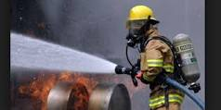
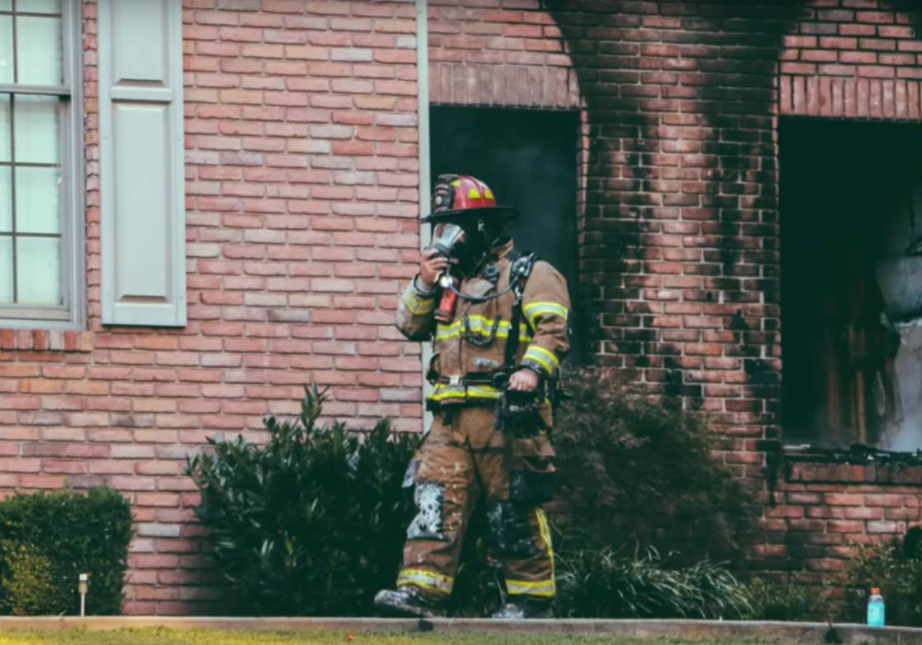
Introduction
Firefighters require some data to make their jobs efficient
Idea to provide a system through which firefighter leader can monitor other squads
Monitor surrounding conditions and gps-coordinates of the firefighters

Slide 3
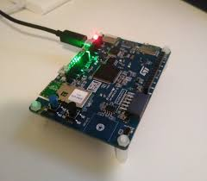
Hardware & Sensors
Hardware: STM32 IoT Discovery Kit
Consists of on-board sensors:
Temperature
Pressure
Accelerometer, gyroscope
Air quality sensor
GPS (connected externally)

Slide 4
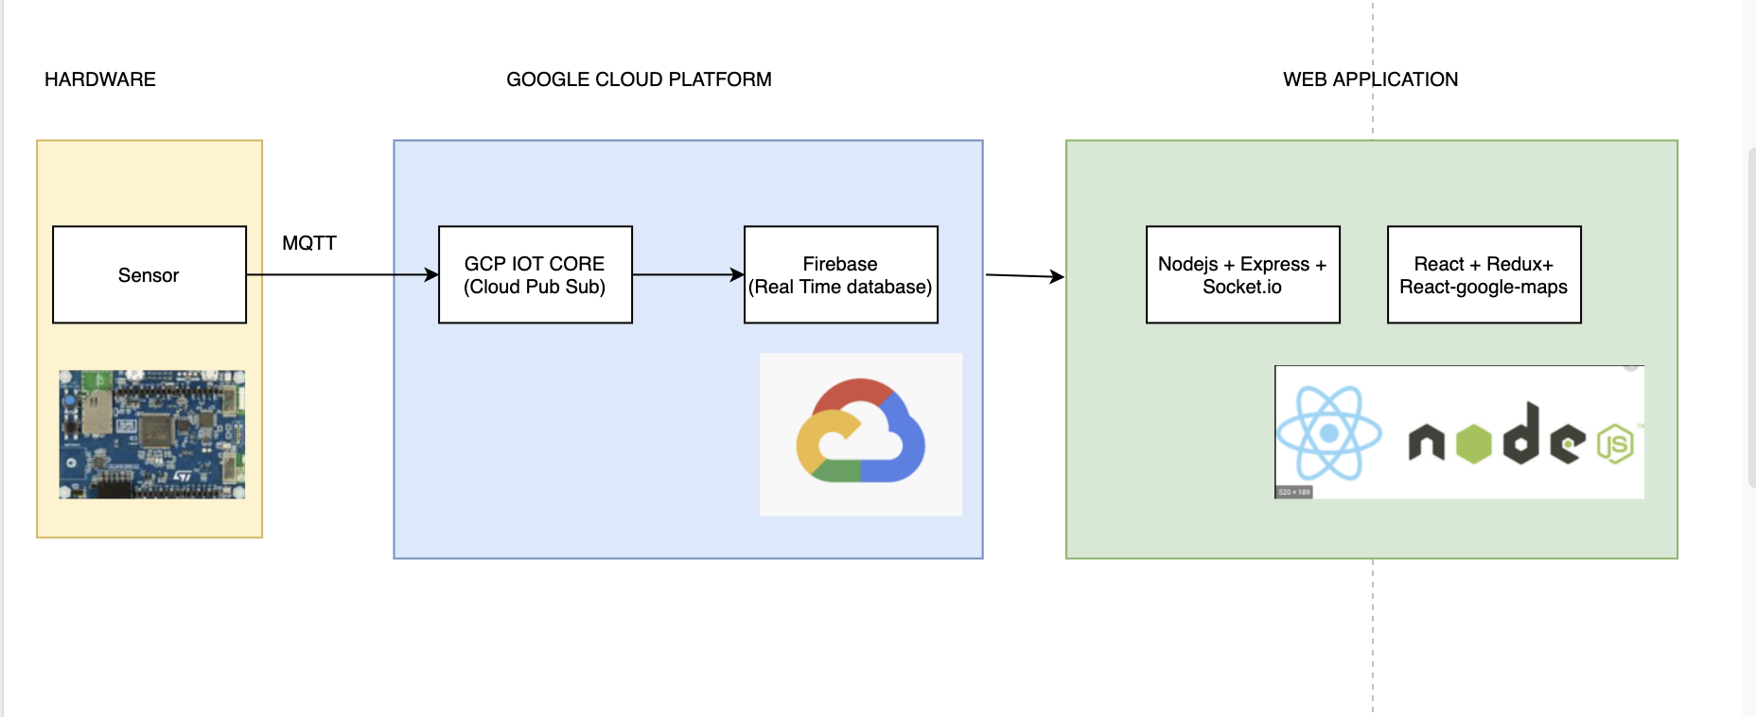
Flow Diagram

Slide 5





React
Firebase
Redux
Google Cloud Pub Sub
Socket.io
Node js

Slide 6
DEMO
https://divine-precinct-243419.uc.r.appspot.com/login

